Slide 1
Lecture
Access – Tables

Slide 2
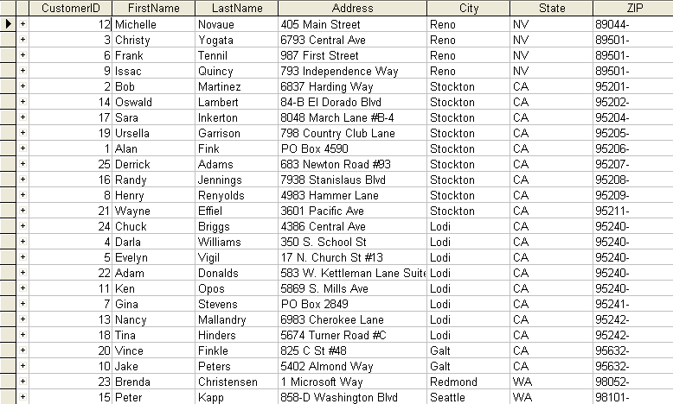
What are Tables?
Records
Fields

Slide 3
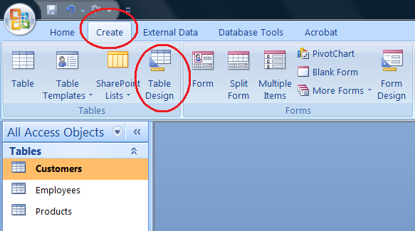
Creating a New Table
Create Ribbon
Table Design
Access 2007
Access 2007

Slide 4
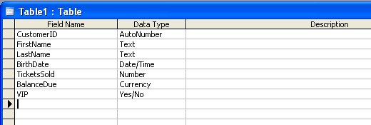
Adding Fields
The name of the Field to be used throughout the Database. Field names must be unique per table.
Avoid using spaces, and be careful with your spelling.

Slide 5
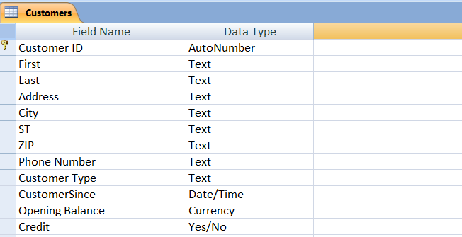
Field Data Types
Data Types specify the kind of information that is going into each Field. This helps keep the data consistent, so that you can use it later in Reports and Queries. What good is a Number field if someone types text into it, right?

Slide 6
Field Data Types (cont.)
Text
Memo
Number
Date/Time
Currency
AutoNumber
Yes/No
Press F1 while choosing a Data Type for help on the available choices!

Slide 7
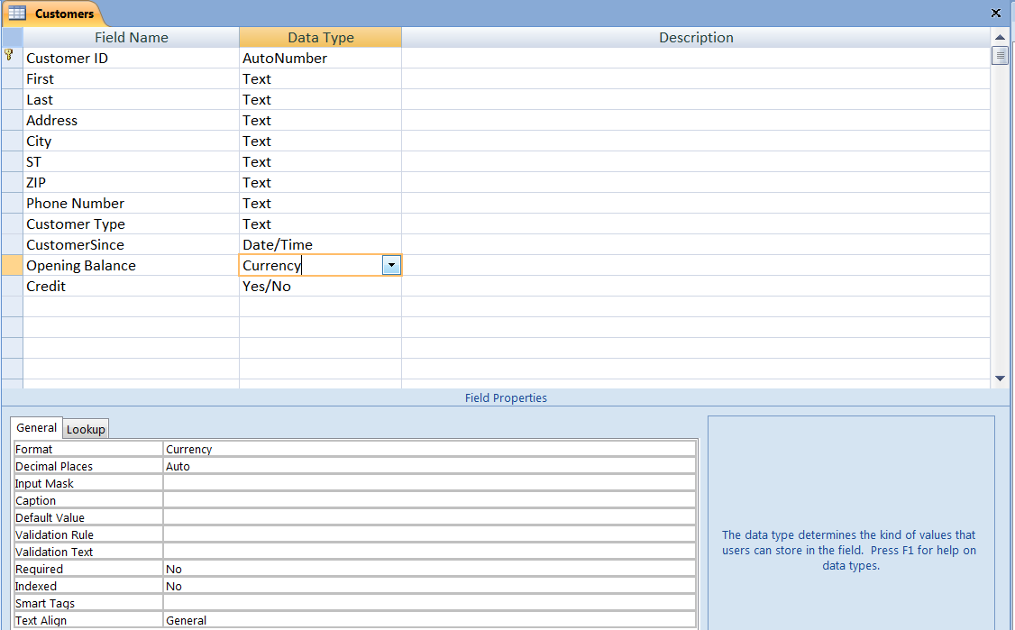
Field Properties
Each Field, in addition to its Data Type, has a number of Properties that can further define its behavior. A text field, for example, can be limited in its size, be required, have a default value, etc. This can help your users save time and ensure your data stays clean.
Help on each Property appears here.

Slide 8
Field Properties (cont.)
Field Size
Format
Decimal Places
Input Mask
Default Value
Required
These are the more common Field Properties.
Your choice of Field Properties will depend on the Data Type you are modifying.

Slide 9
Primary Keys
The AutoNumber datatype is great for primary keys because they are automatically assigned as new records are added, and cannot be changed.
When you save a Table for the first time, Access will recommend you designate a Primary Key.

Slide 10
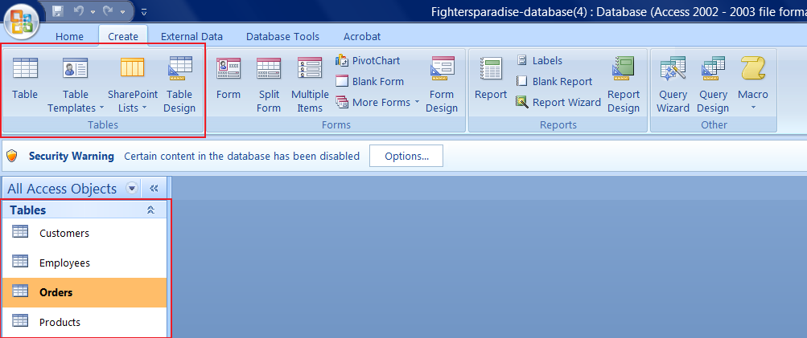
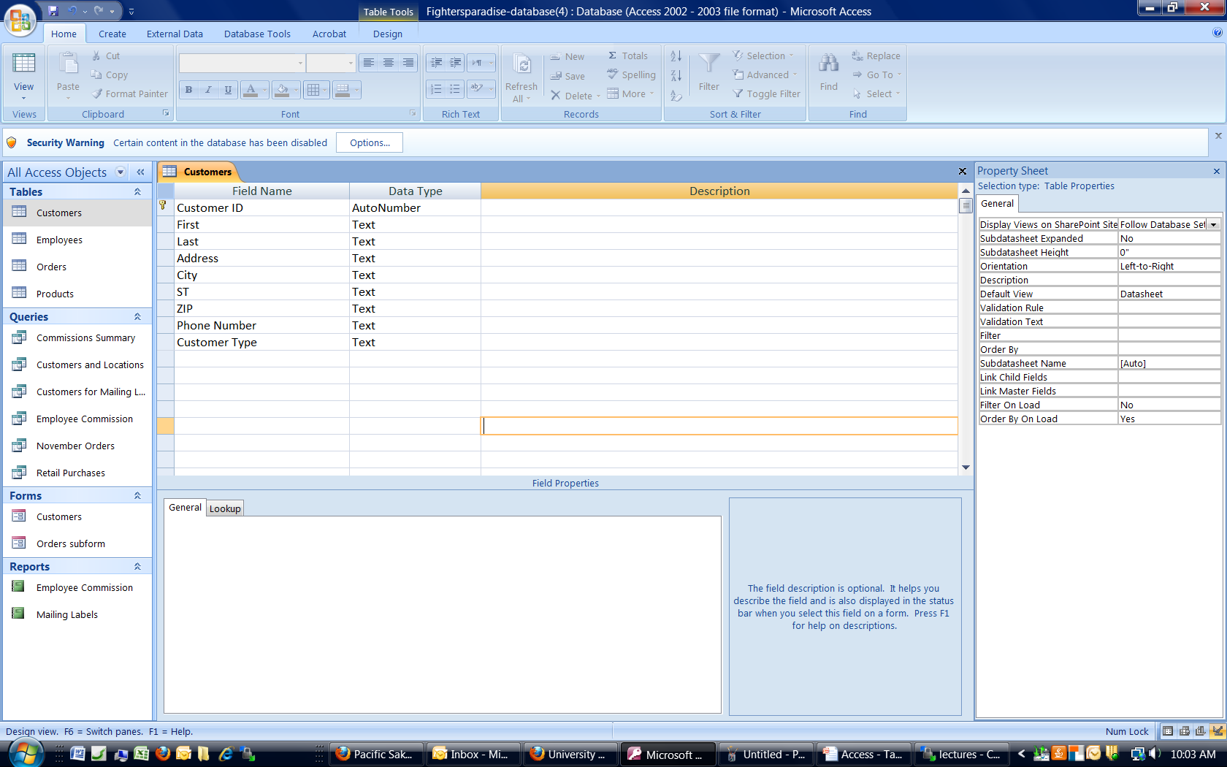
Viewing Table Data
Toggles between Design and View mode.
Double-Click

Slide 11
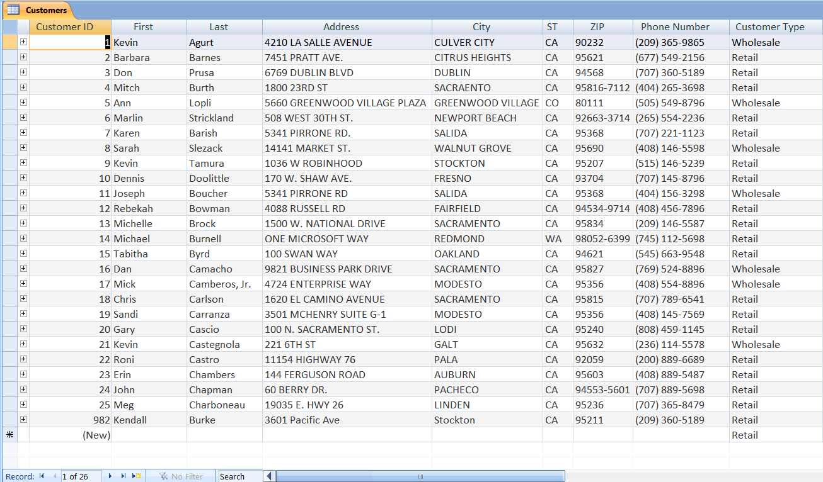
Editing Table Data
Edit data just like Excel.
“Empty” record ready for data
Record navigation and count.

Slide 12
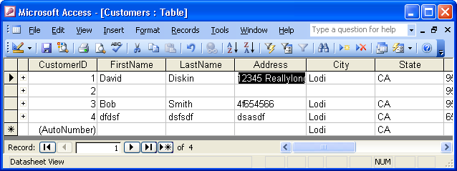
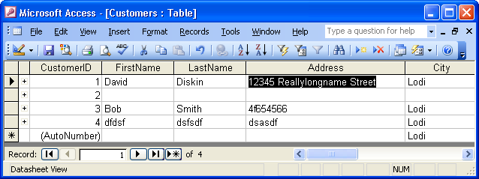
Column Width

Slide 13
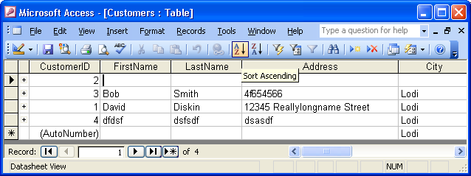
Sorting

Slide 14
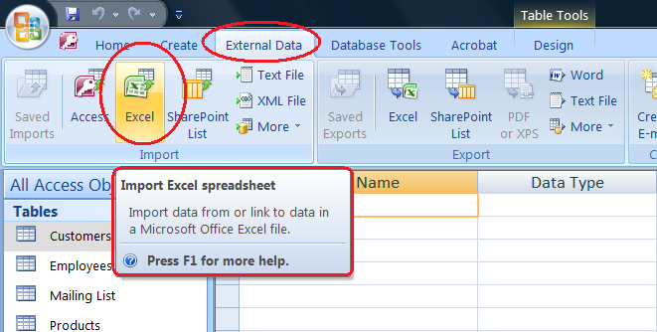
Access with Excel
Access and Excel “talk” to each other:
  Importing
  Exporting
  Linking

Slide 15
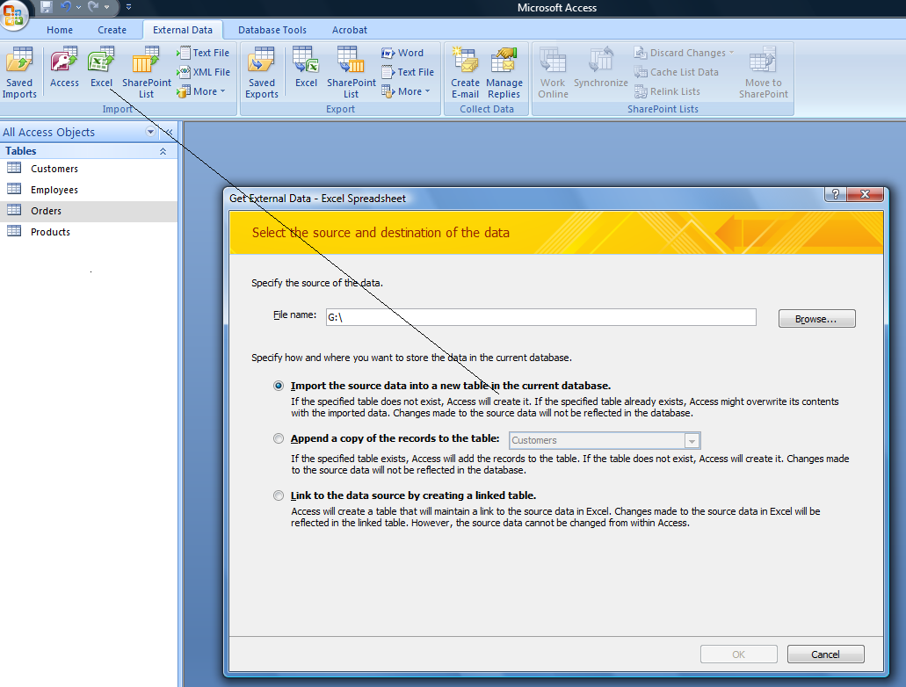
Importing from Excel

Slide 16
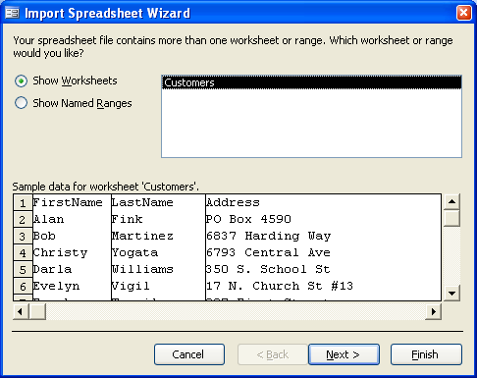
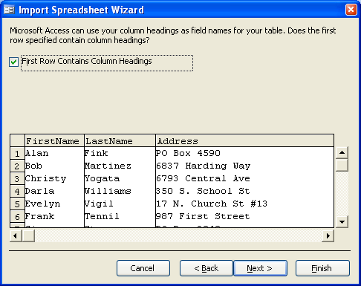
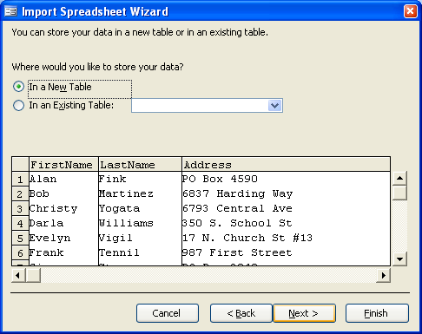
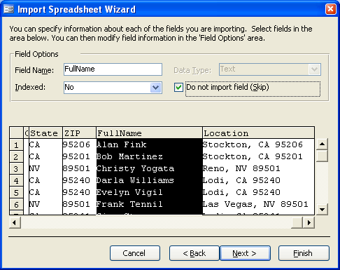
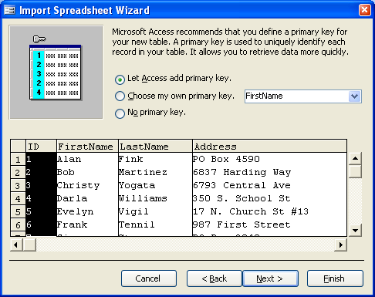
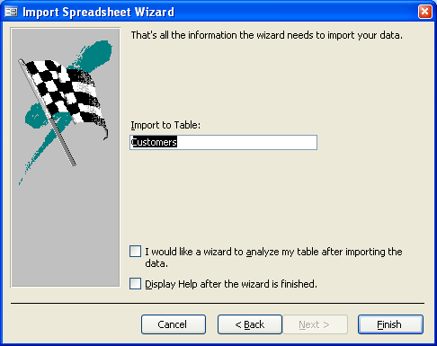
Importing from Excel (cont.)
Do not import the FullName or Location columns.

Slide 17
Table Relationships
Payments
Invoices
Employees
Databases almost always have multiple tables that are all related.
Line Items
Customers

Slide 18
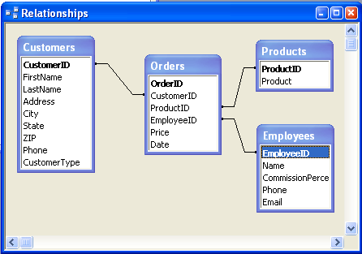
Relationships in Access
Databases store the Relationships between tables to keep things straight.
When a Lookup is defined for a field, a Relationship is automatically created.
In Access, Relationships are displayed with the Relationships toolbar icon.

Slide 19
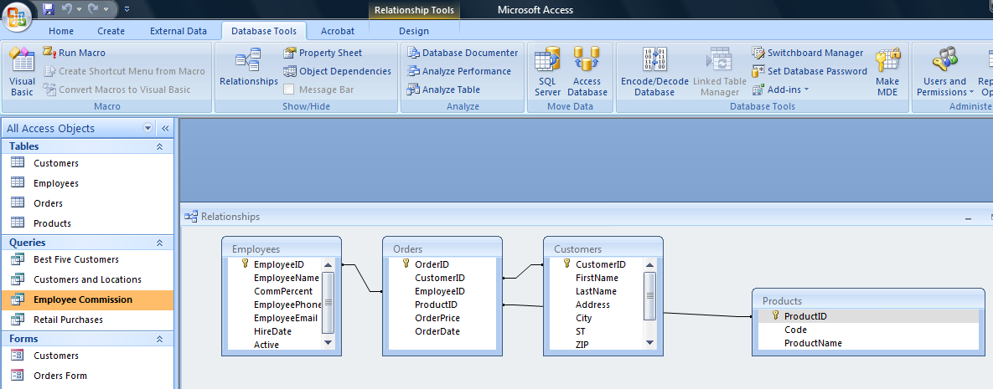
Relationships in Access

Slide 20
Lookup Fields
Create a drop-down menu
Menu choices can be linked to other tables (dynamic) or specified (static)
Used to link records across tables, ie:
  Invoice to Customer
  Employee to Invoice
Can require user to choose from your list
(great for consistency)

Slide 21
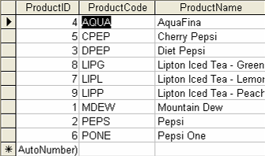
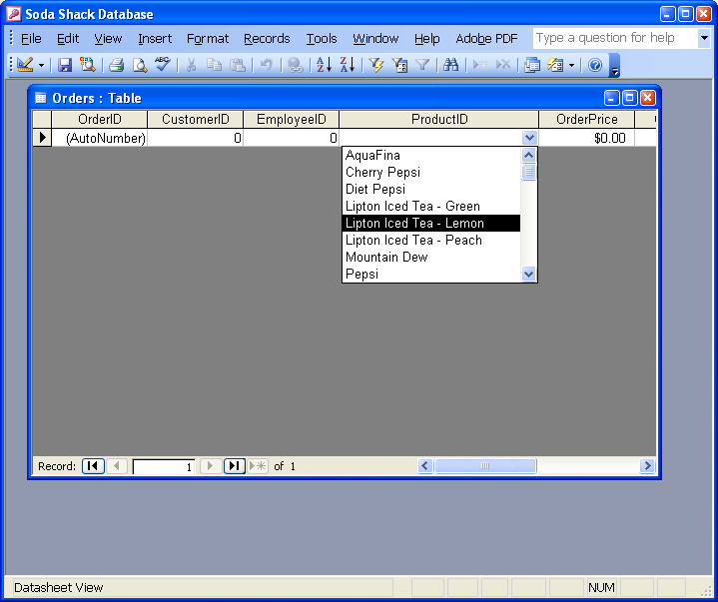
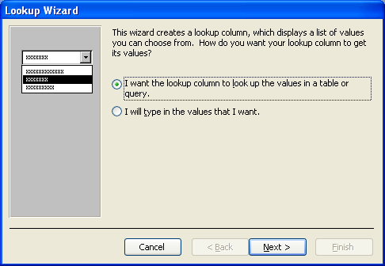
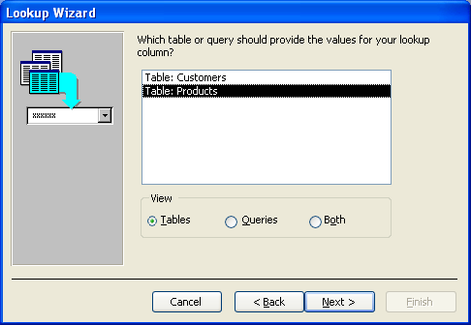
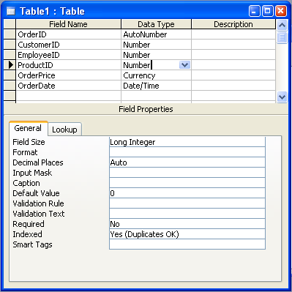
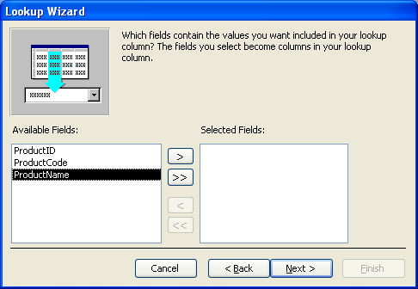
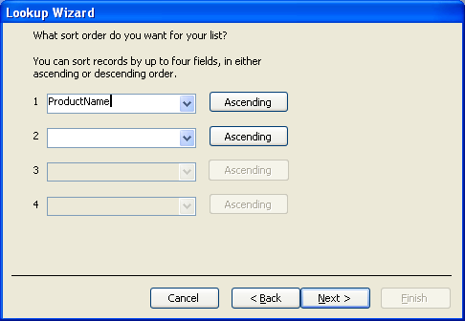

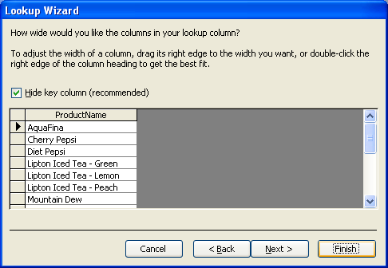
Lookup Fields (cont.)
In our Orders table, we want the ProductID field to be a drop-down choice based on the Products table. We want to show the Product Name but store the ProductID number.

Slide 22
Helpful Hints
Always have a Primary Key
ZIP Codes and Phone Numbers are Text
Double-check your spelling
Spaces matter, CAPS do not
Percentages are Numbers, with field size Single, and .00% as inputmask
Test a Lookup as soon as you make it

Slide 23
Close Access BEFORE you upload
Temp “locked file” open
Access must be closed to effectively close this file
If you upload while Access is open, the database becomes damaged and unusable.

